Slide 1

HIV-1 specific restriction factors increase in response to viral rebound after analytical treatment interruption
De Scheerder Marie-Angélique, Van Hecke Clarissa, De Langhe Nele, Sips Magdalena, Vandekerckhove Linos
AIDS 2018, 25/07/2018, WEAA02

Slide 2

1. INTRODUCTION: HIV-STAR STUDY AND RESTRICTION FACTORS
2. Objectives-HYPOTHESIS
3. METHODS
4. RESULTS
5. CONCLUSION
CONTENT

Slide 3
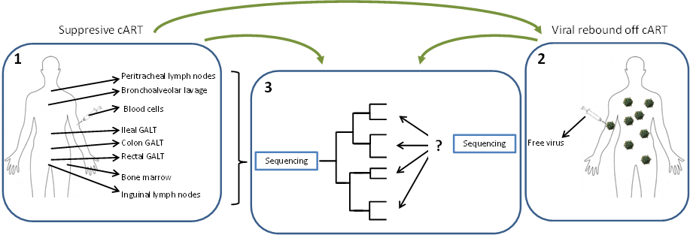
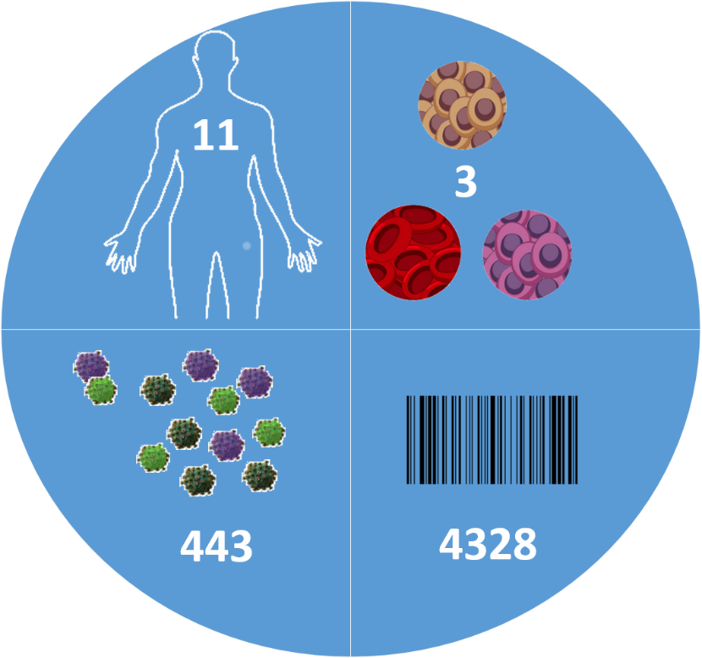
HIV-STAR study
Treatment interruption trial to link the rebounding virus to a specific compartment
How do participants experience analytical treatment interruption trials: lessons learned from the HIV-star STUDY
ABSTRACT NUMBER: THPEB096
POSTER SESSION: Thursday 26/07/2018 12:30-14:30
To be expected soon
HIV-STAR: NCT02641756

Slide 4
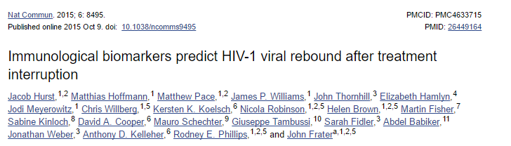
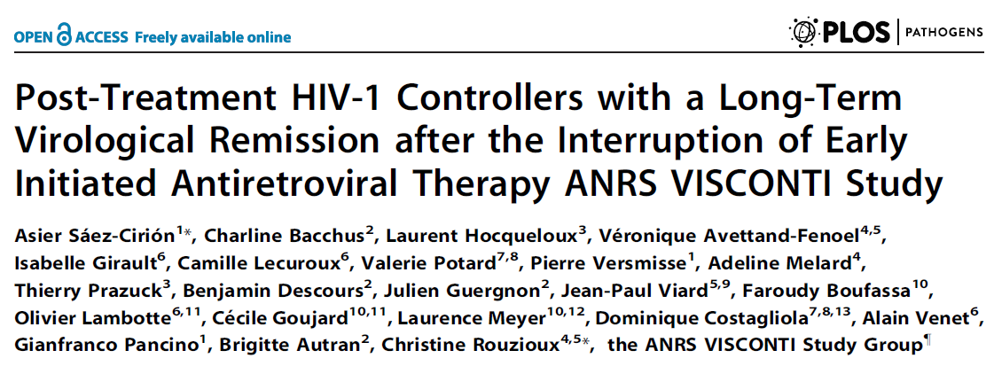
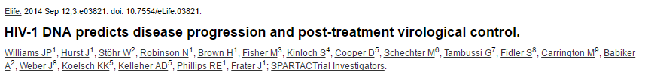
Are there biomarkers that can predict the TTVR?
T-cell exhaustion markers PD-1, Tim-3 and Lag-3
Early treatment initiation
HIV-1 DNA
Can restriction factors serve as a biomarker?

Slide 5
RESTRICTION FACTORS
Host proteins
INNATE Immune response
INTERFERE with HIV-1
GOAL: limit viral production and spreading
BUT Counteraction by HIV-1 accessory proteins (Vif, Vpx, Nef etc.)
Jia X, Zhao Q, Xiong Y. HIV suppression by host restriction factors and viral immune evasion. Current opinion in structural biology. 2015;31:106-14.
Notes:
APOBEQ: causes hypermutation viral reverse transcriptase <-> vif, vpr
SAMHD1: depleting dNTPs <-> vpx (absent in HIV-1)
MX2:
BST2/tetherin: budding <-> vpu
Trim 5: after entry
SLFN 11: induced by IRF3, later stage of the cycle
PAF1: early stage

Slide 6
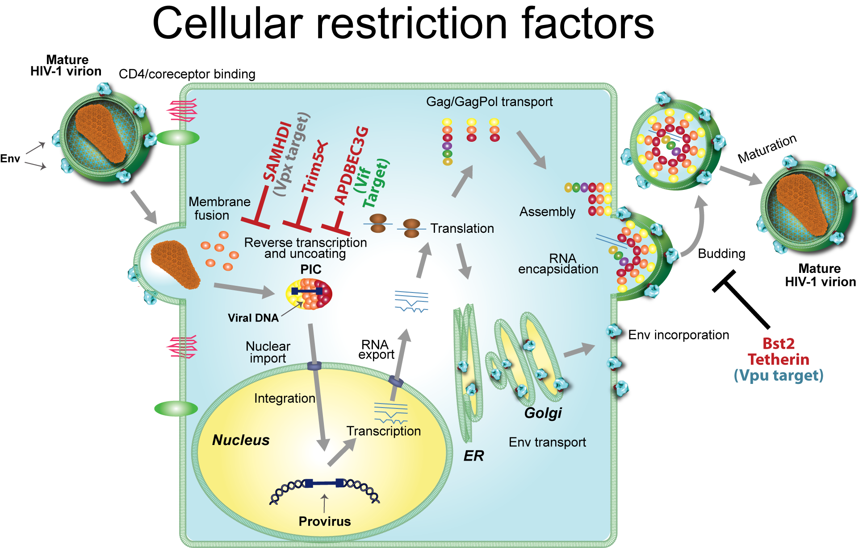
ReStriction factors
http://www.hivsystemsbiology.org/mediawiki/index.php/HIV_and_host_factors

Slide 7
OBJECTIVES-HYPOTHESIS
  HYPOTHESIS: The expression of HIV- specific restriction- and cofactors fluctuates in relation to the change of viral load at the different time points, with a higher viral load after ATI and as a result a higher expression of restriction factors.
  Restriction factor (APOBEC3G, MX2, SAMHD1, BST2/tetherin, TRIM5, SLFN11, PAF1) and cofactor (PSIP1, NLRX1) expression before, during and after analytical treatment interruption (ATI).
  Interrelation with the innate immune response: IFIT1, MX1.
  Participants characteristics (CD4 nadir, viral load zenith, total HIV DNA, time to viral rebound…).
Notes:
Co-factors: neg regulators of innate immunity, depletion limits HIV-1 infectivity
PSIP1 encodes for LEDGF PIC to the site of integration
NLRX1: limits IFN signalling

Slide 8
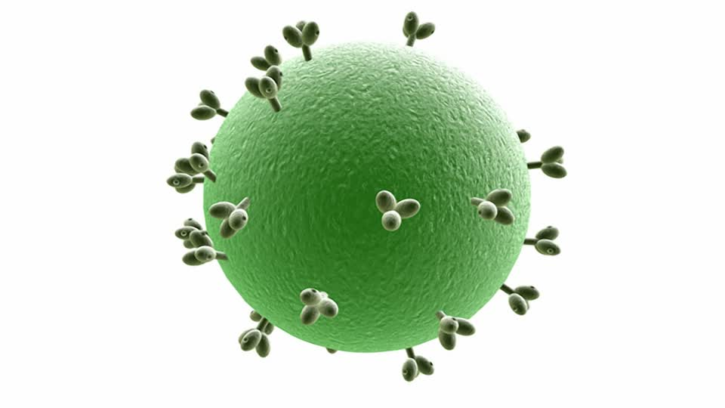
METHODS: samplING
cART
Treatment interruption
cART
Analytic treatment interruption = D0
Restart cART
Intense follow-up of VL and CD4 count 2x/w
D7 –15
D15–36
Restart+90
T1: PBMC collection through leukapheresis as part of in depth sampling
T2: PBMC collection through leukapheresis
T4: PBMC collection through peripheral blood draw
T3: PBMC collection through peripheral blood draw
VL

Slide 9

METHODS: analysis
cDNA synthesis
RNA-extraction + Qubit
qPCR analysis
qPCR-analysis
Statistical analysis
    Friedman/post hoc Dunn test
    Spearman correlation

Slide 10
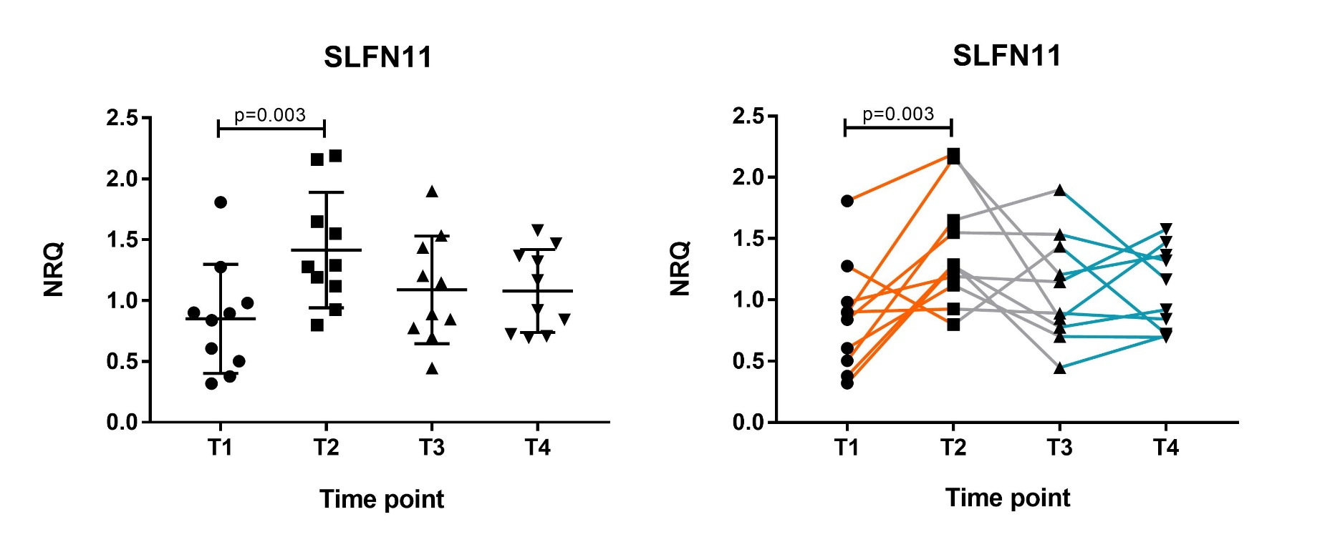
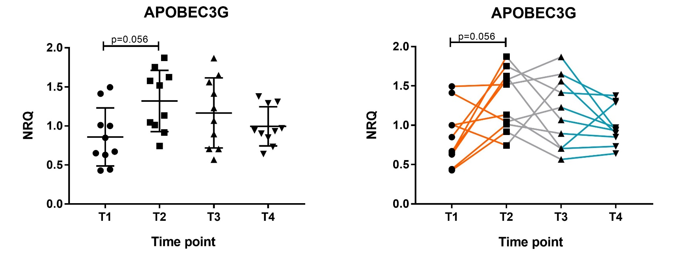
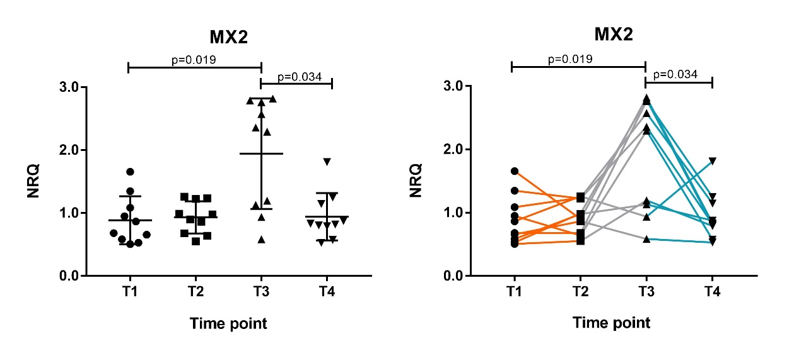

RESULTS: expression OF restriction factors and cofactors
Significant:
  APOBEC3G (p=0.026)
  SLFN11(p=0.006)
  MX2 (p=0.012)
Notes:
Friedman: significant difference between at least two timepoints -> post hoc Dunn borderline sign p value for APOBEC(Borderline) significant difference in expression between T1 and T2 for the restriction factors APOBEC3G (p=0.056) and SLFN11 (p=0.003), between T1 and T3 for MX2 (p=0.019) and between T3 and T4 for MX2 (p=0.034) were observed.
Similar trend

Slide 11
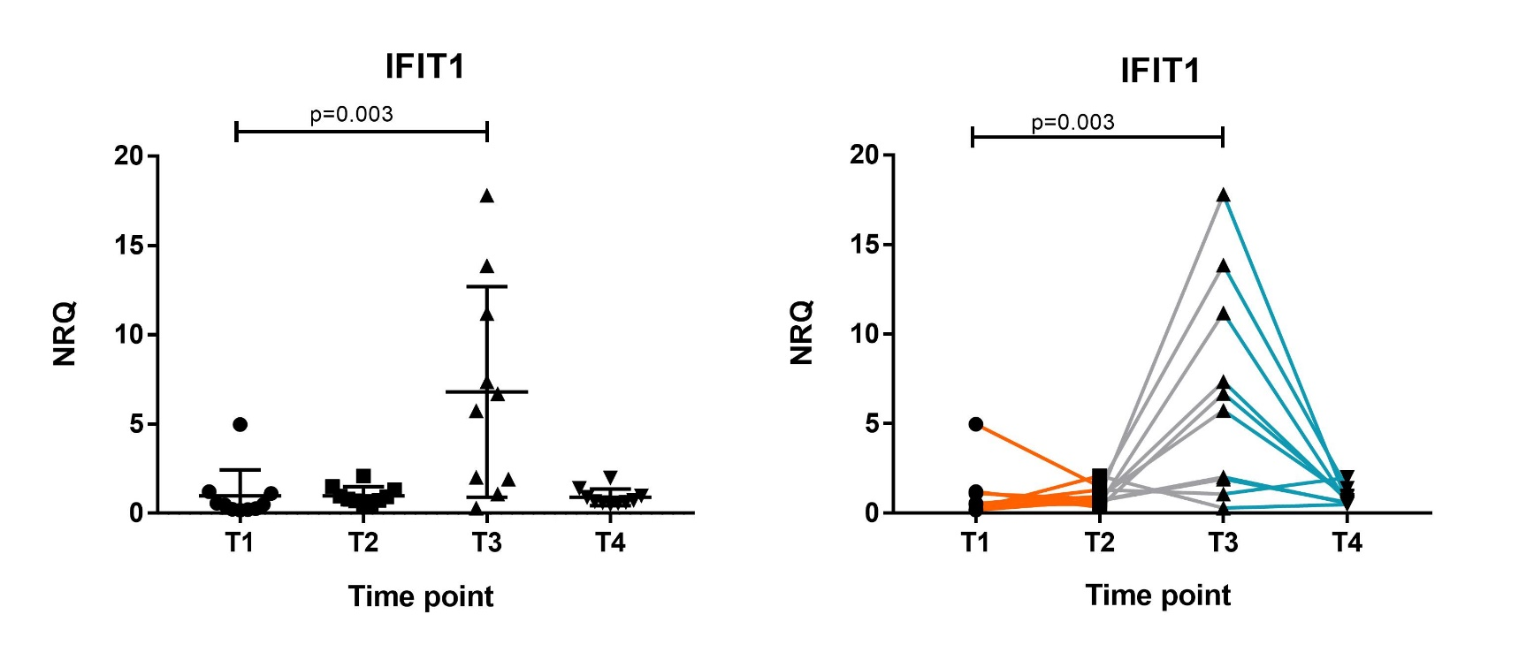
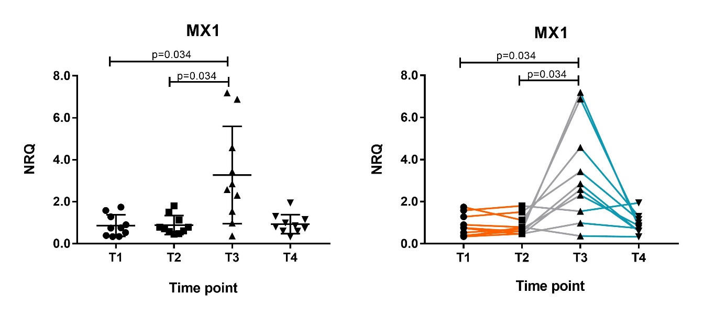
RESULTS: expression of ISGs
Significant:
- IFIT1 (p=0.006)
- MX1 (p=0.016)
Notes:
A significant difference in expression levels was defined between T1 and T3 for both ISGs, MX1 (p=0.034) and IFIT1 (p=0.003) and between T2 and T3 for MX1 (p=0.034).

Slide 12
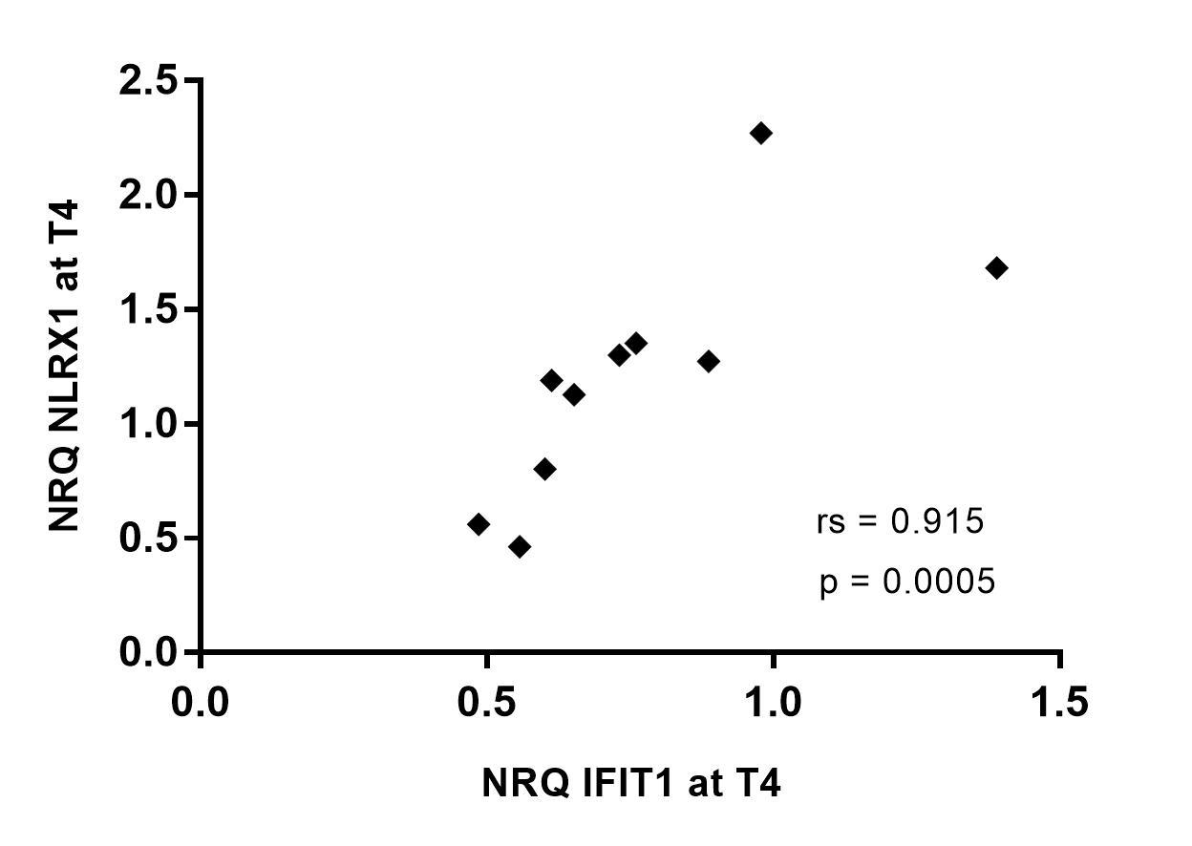
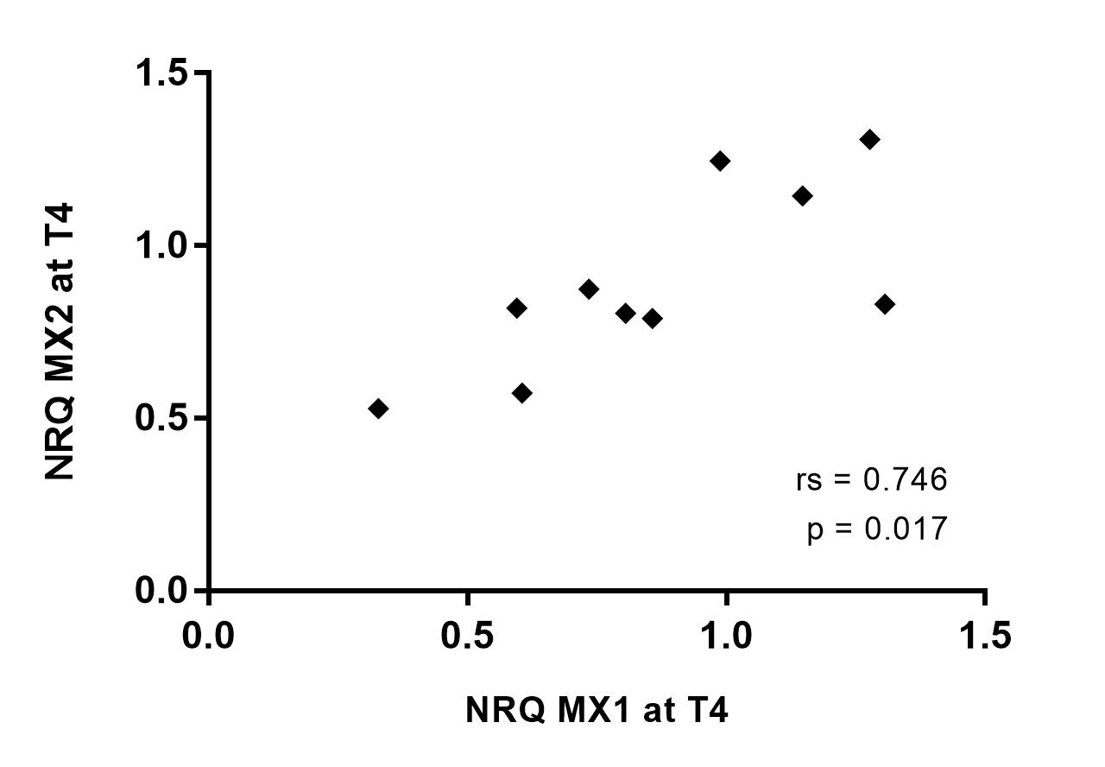
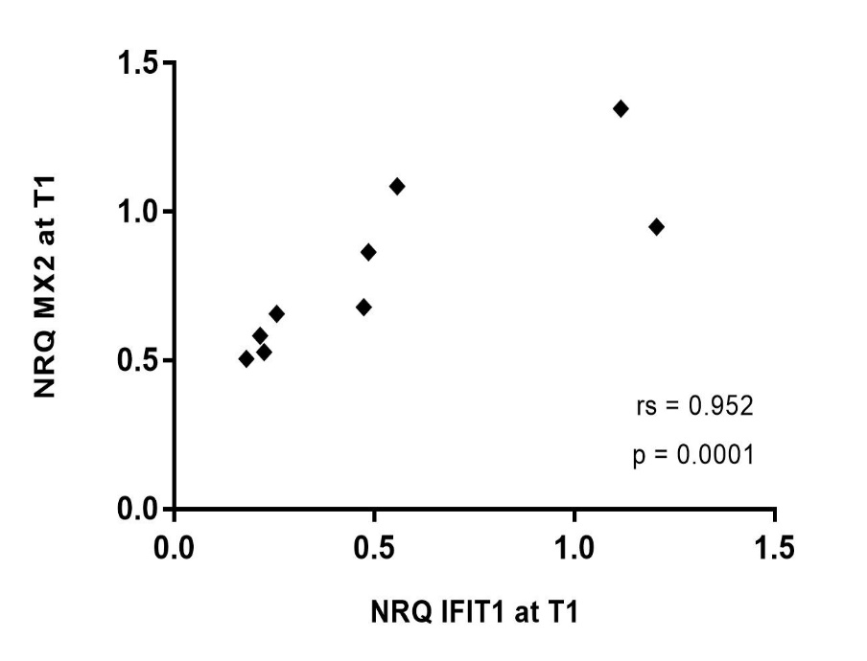
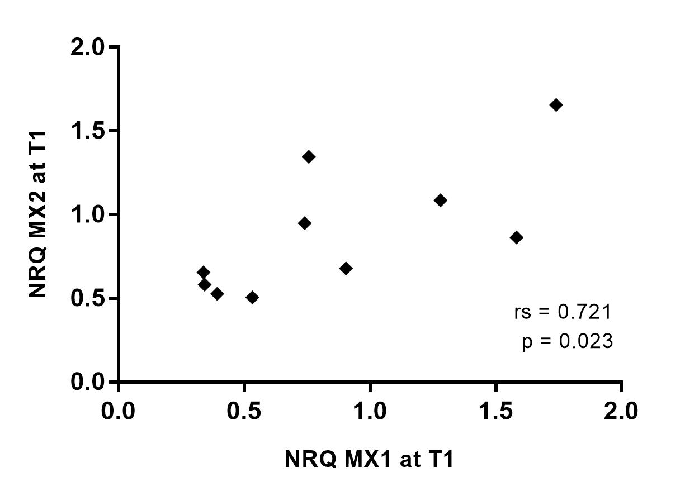
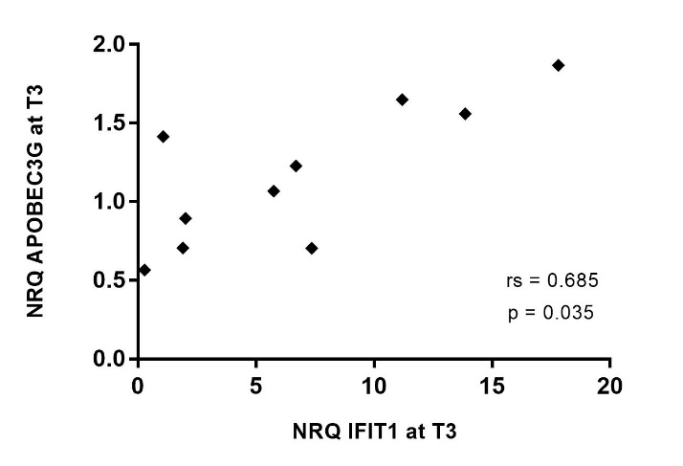
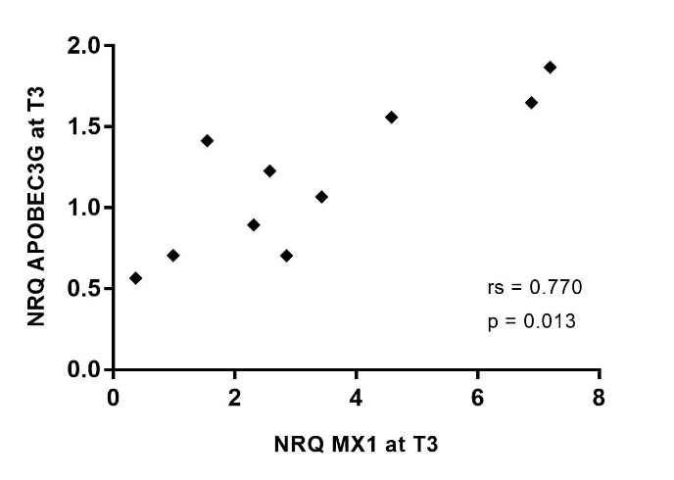
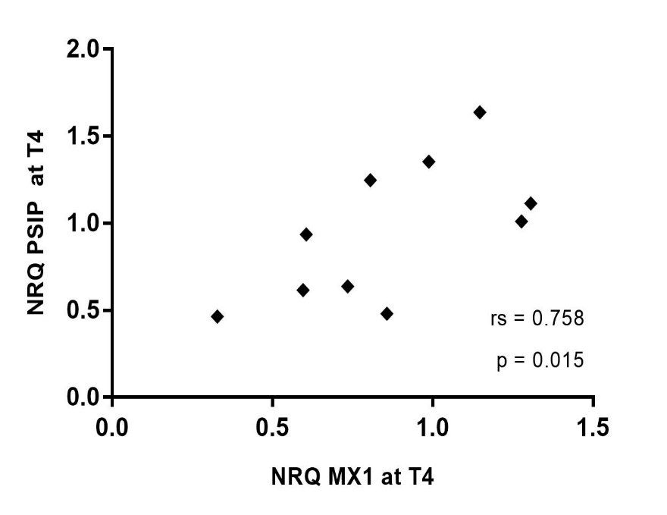
Results: correlations RFs - ISGs
Notes:
Significant positive correlations between ISG and restriction factor/cofactor expression: at T1 between IFIT1/MX1 and multiple restriction factors, at T3 between the expression of IFIT1 and various restriction factors as well as between MX1 and all restriction- and cofactors except PAF1, and finally at T4 between the expression of IFIT1 and NLRX1 and between MX1 expression and MX2 and PSIP1 expression. At T2, no significant correlations were found.

Slide 13
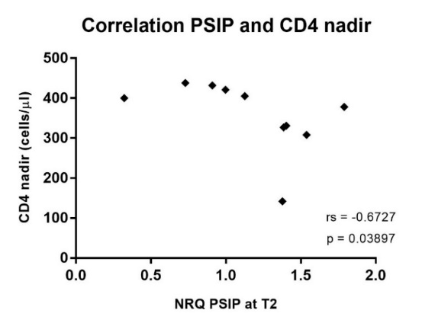
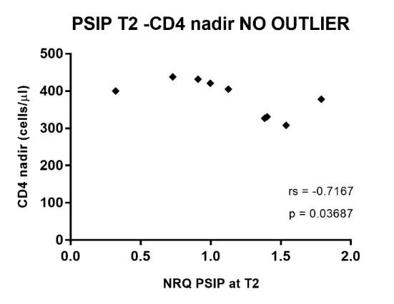
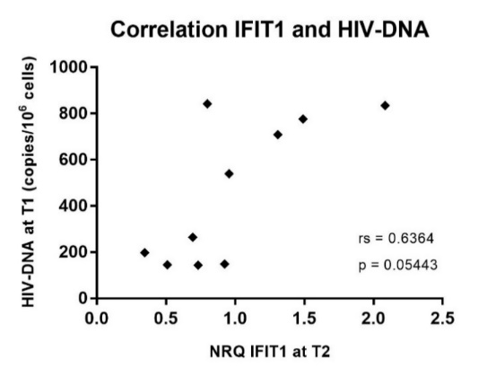
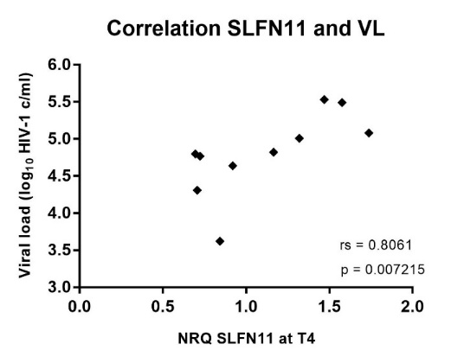
RESULTS: Correlation with participants characteristics
No correlation with TTVR
Correlation PSIP1
and CD4 nadir
- Correlation IFIT-HIV DNA and SLFN11-VL zenith
Notes:
Correlation PSIP1 and CD4 nadir with/without outlier. In both graphs the expression at T1 (under cART) of the cofactor PSIP1 is plotted against the CD4 nadir (cells/µl). In the right graph, the outlier (STAR-4) was excluded. A significant negative correlation was found, with (rs=-0.67273, p=0.038967) or without the outlier (rs=-0.7167, p=0.03687).
Correlations: IFIT1 - HIV-DNA and SLFN11 – VL zenith. In the expression at T2 (STOP) of IFIT1 (NRQ) is plotted against the amount of HIV-DNA (copies/10⁶ PBMCs). A borderline significant positive correlation was found (rs=0.636364, p=0.054431). Right, the expression at T4 of the restriction factor SLFN11 is plotted against the viral load zenith (VL, log₁₀ HIV-1 copies/ml). A significant positive correlation was found (rs=0.806061, p=0.007215).

Slide 14
CONCLUSION
A difference in restriction factor expression between time points is confirmed.
  HOWEVER, these findings are only significant for 3 of the chosen restriction factors.
  Overall restriction factor expression seems to increase before the interferon-stimulated genes.
Correlation with patient characteristics
  Some RF are positively correlated with factors associated with severity of disease (high HIV DNA load - high viral load zenith)
  -> increased immune response
  A low CD4 nadir was correlated with a higher expression of the viral cofactor PSIP1 -> decreased antiviral activity
  NO correlation between the expression of restriction- or cofactors and time to viral rebound

Slide 15
Future perspectives
  Analyse the expression of restriction factors in relevant cell subsets and peripheral tissues.
  Increase sample size? Include more/other restriction factors?
  - Investigate the other pathways that might be involved in RF expression
  - Longitudinal analysis of the expression of both restriction factors and other biomarkers related to HIV persistence: immune exhaustion/activation markers (PD1, LAG-3, …), HLA types…

Slide 16
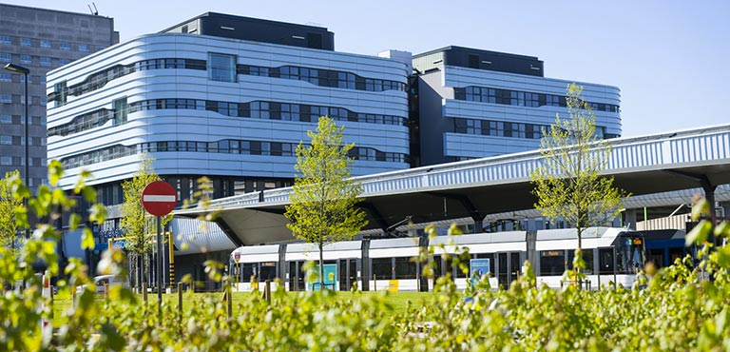
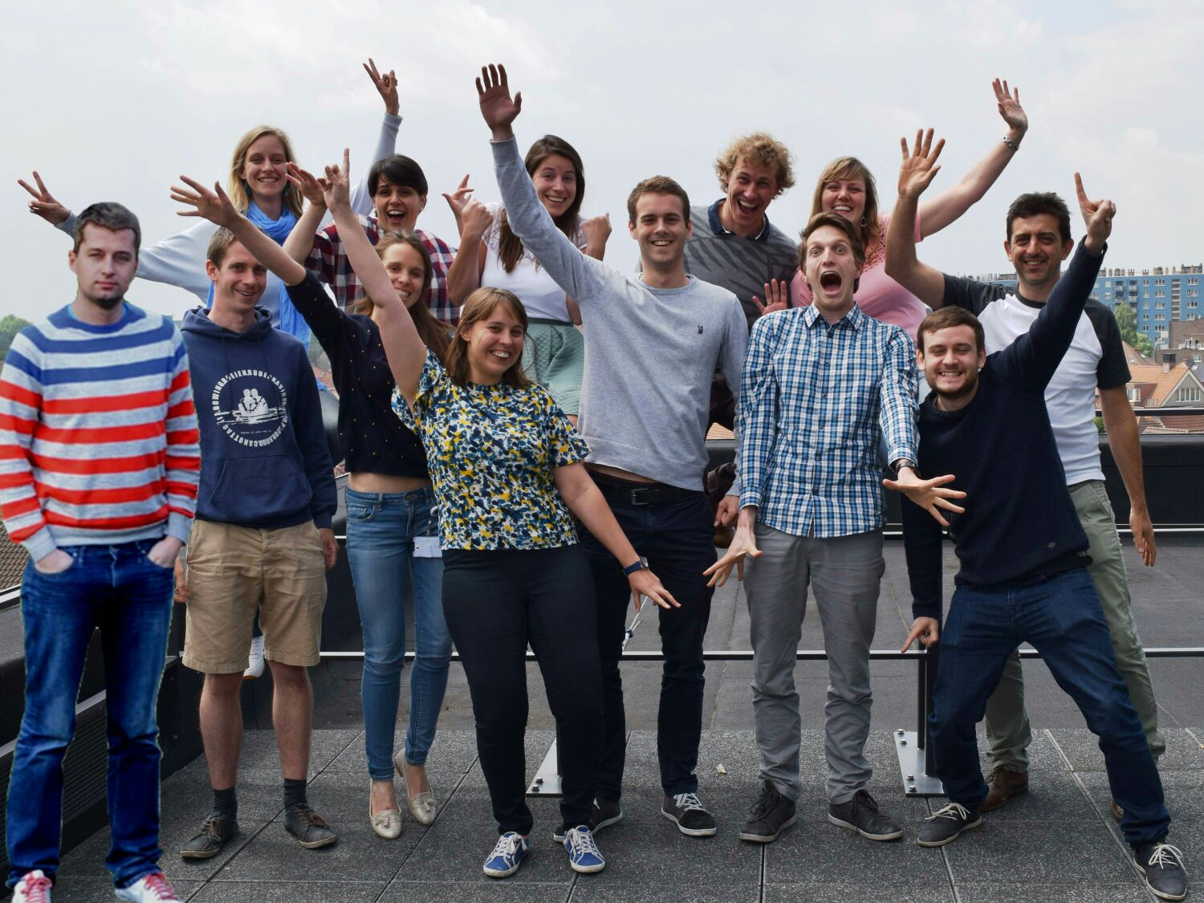
THANK YOU FOR YOUR ATTENTION!
Acknowledgements
HIV-STAR cohort
University of Ghent-HCRC
Ghent University Hospital
Funding: Investigator grant MSD

Slide 17
HIV-STAR STUDY: OVERVIEW PARTICIPANTS
Notes:
Average 23 d
Average age 43 y

